Slide 1
Machine Learning in Breast Cancer Classification
Jana Hoffmann
Jessie Midgley
Julia Graf
Maike Nägele
Tutor: Anupam Gautam

Slide 2
Overview
01
02
03
04
Dataset
Models
CBIS-DDSM
ResNet-50
VGG-16
Model Training
Results & Outlook
Image preprocessing
Image augmentation
Validation

Slide 3
Dataset: CBIS-DDSM
1590 calcification images
1696 mass images
571 malignant
1019 benign
784 malignant
912 benign
(Lee, 2017)

Slide 4
Models: ResNet-50
2
benign
Softmax
InputLayer
ID Block x 2
ID Block x 3
ID Block x 5
ID Block x 2
Flattem
AveragePooling
BatchNorm
Fully Connected
Conv2D
ConvBlock
ConvBlock
ReLu
ConvBlock
ConvBlock
MaxPooling2D
malignant
Stage 1
Stage 2
Stage 3
Stage 4
Stage 5
(Mukherjee, 2022)

Slide 5
Models: VGG-16
benign
Sigmoid
InputLayer
Conv2D
Conv2D
Conv2D
Conv2D
Flattem
MaxPooling2D
MaxPooling2D
Conv2D
Conv2D
Conv2D
Conv2D
MaxPooling2D
MaxPooling2D
Conv2D
Conv2D
Conv2D
MaxPooling2D
Conv2D
Conv2D
malignant
Block 1
Block 2
Block 3
Block 4
Block 5
(Anthony, 2021)

Slide 6
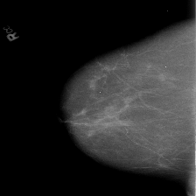
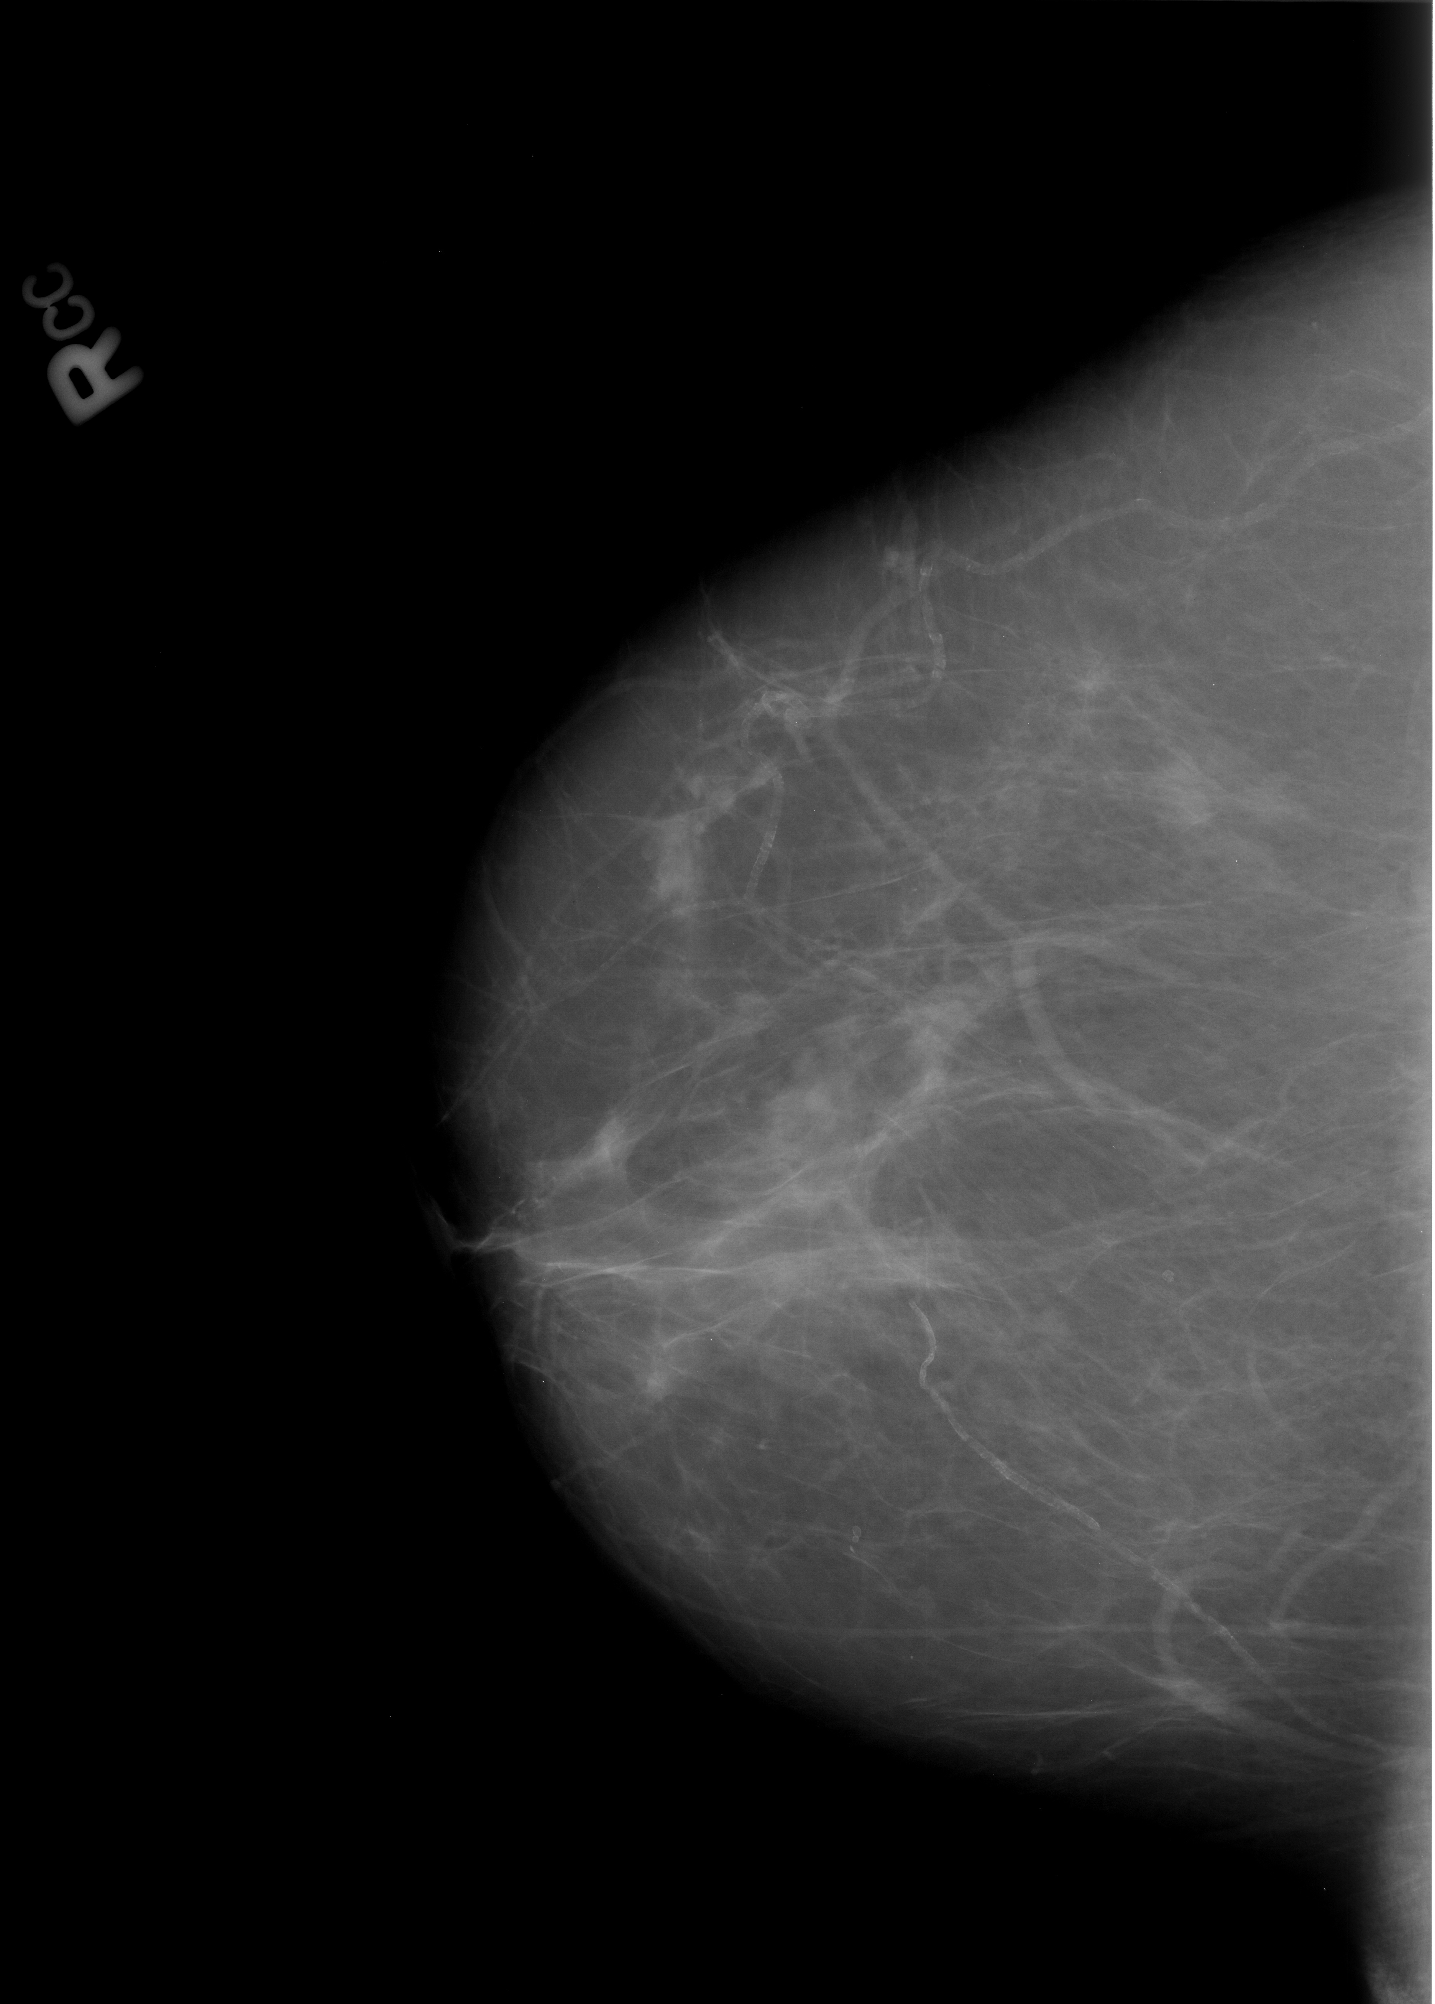
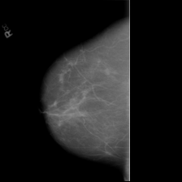
Image Preprocessing
Original image
Skimage resize
Keeping aspect ratio
(Lee, 2017)

Slide 7
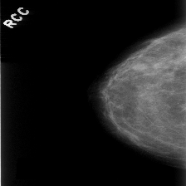
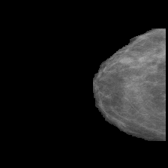
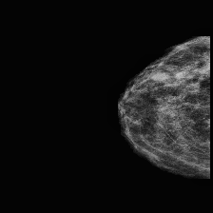
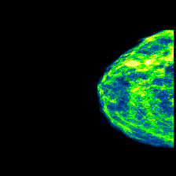
Image Preprocessing
Image Enhancement
Green Fire Blue Filter
Resizing
Artefacts Removal
(Lee, 2017)

Slide 8
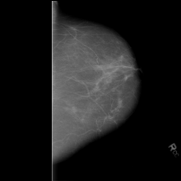
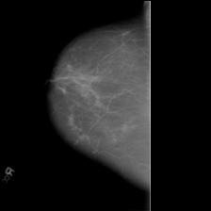
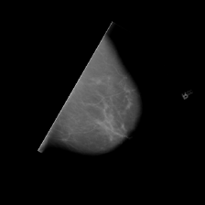
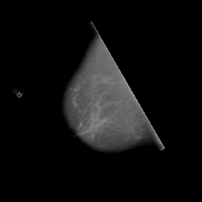
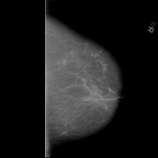
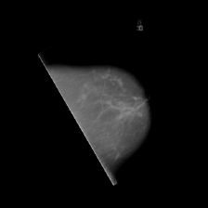
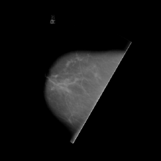
Image Augmentation
18.400
2.300
(Lee, 2017)

Slide 9
Validation
Use model with best metrics on validation set
Train the model on five different train/validation splits
Evaluate the models on the same test set
CBIS-DDSM
Train
Va
l
Test

Slide 10
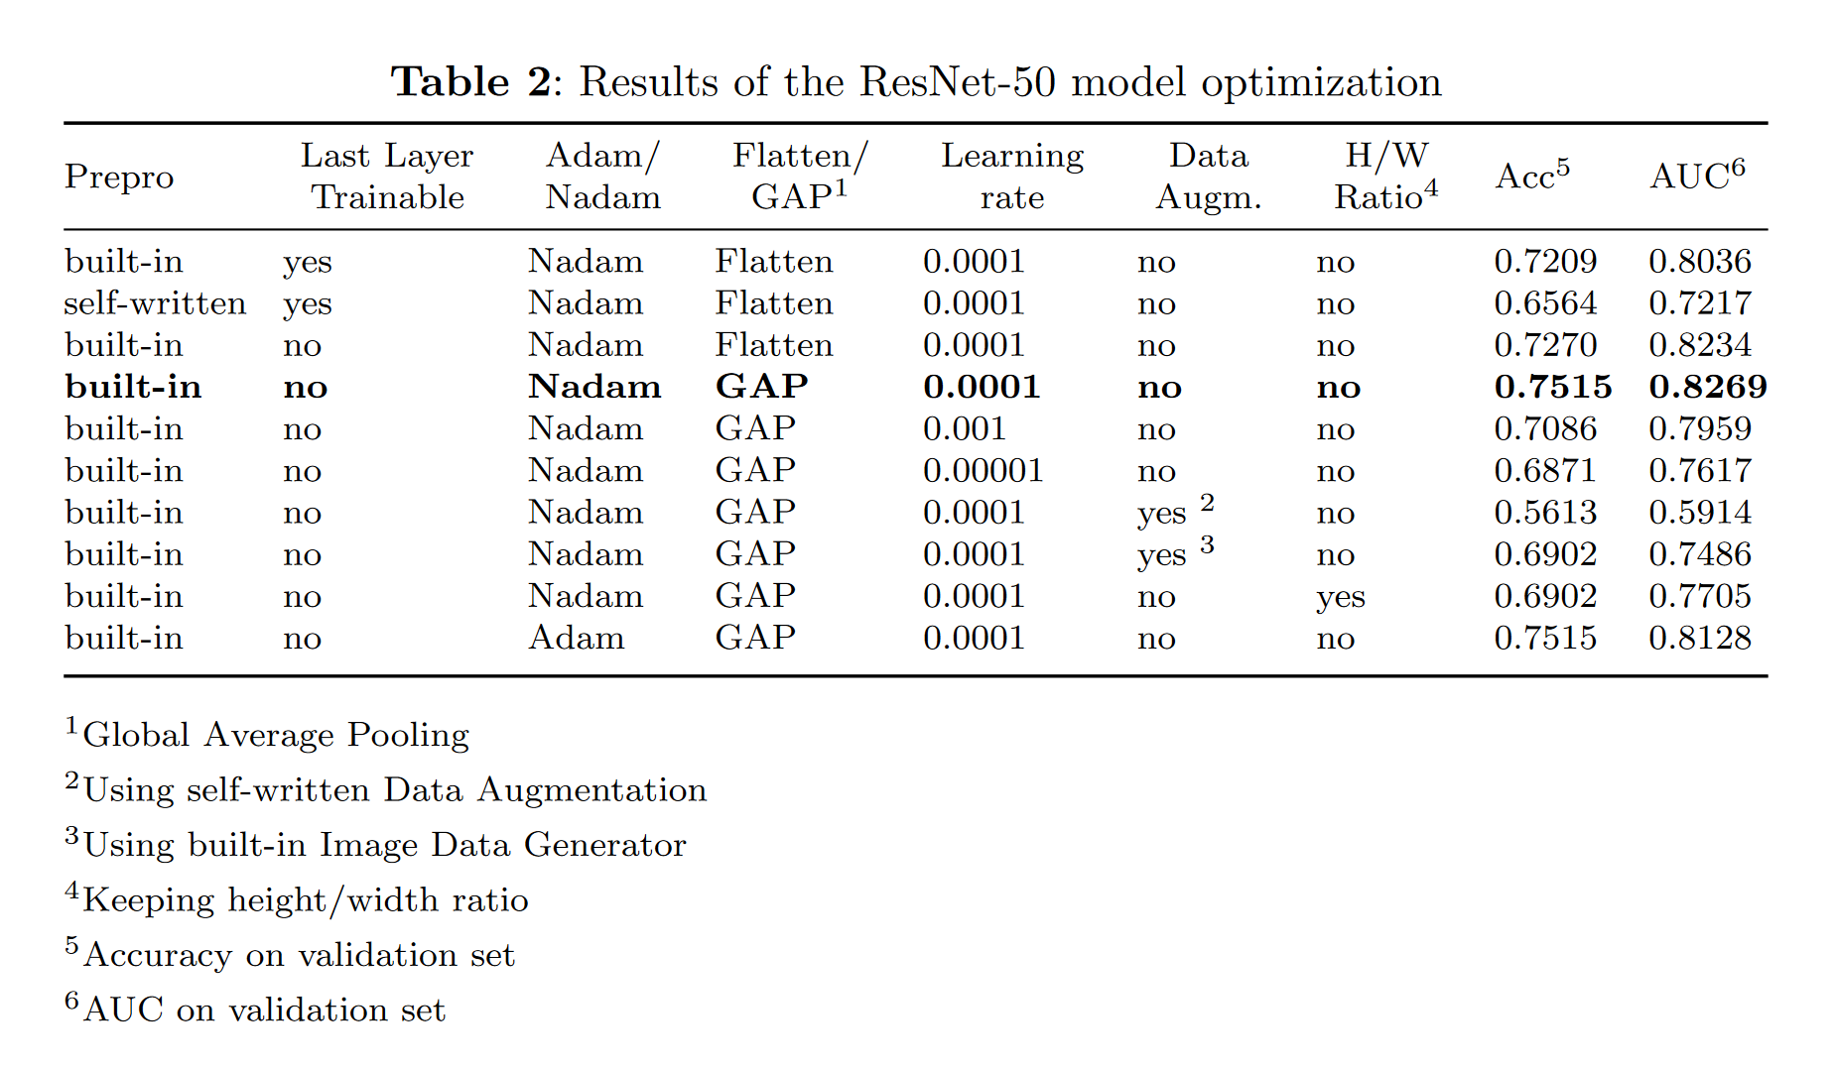
Results: ResNet-50

Slide 11
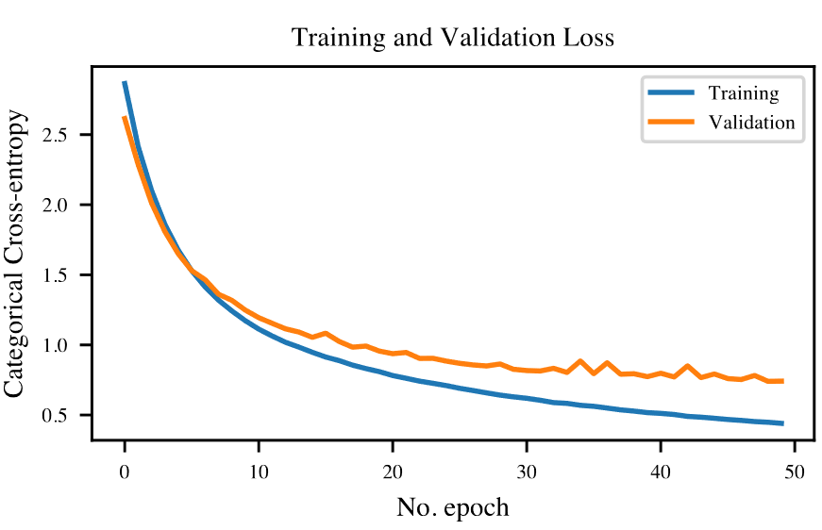
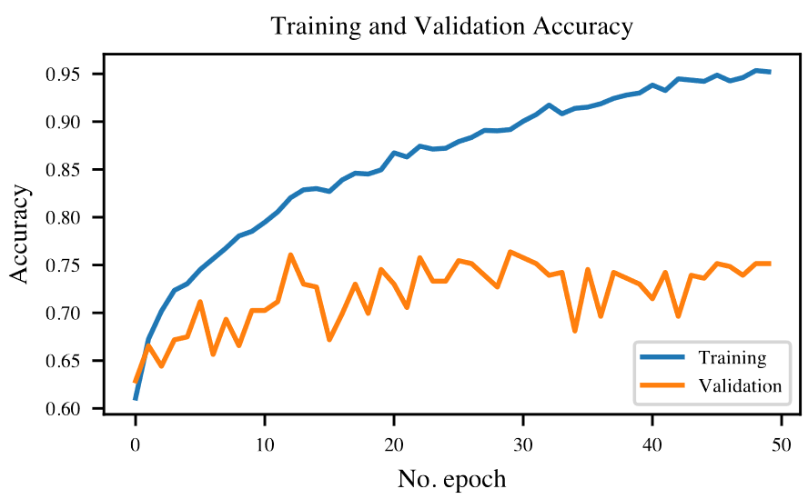
Results: ResNet-50
 | Accuracy | AUC
Training | 0.952 | 0.991
Validation | 0.752 | 0.827

Slide 12
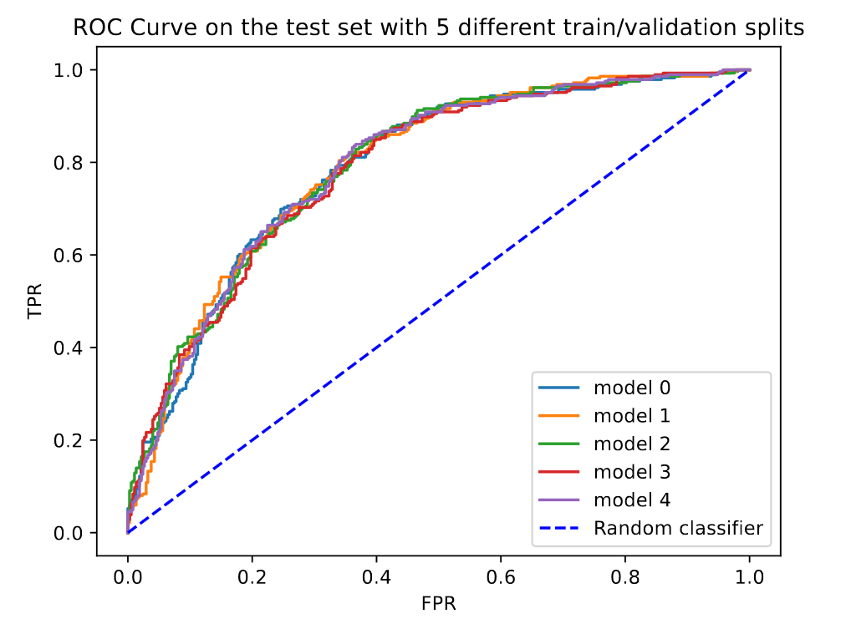
Results: ResNet-50
 | Accuracy | AUC
Test | 0.796 | 0.719

Slide 13
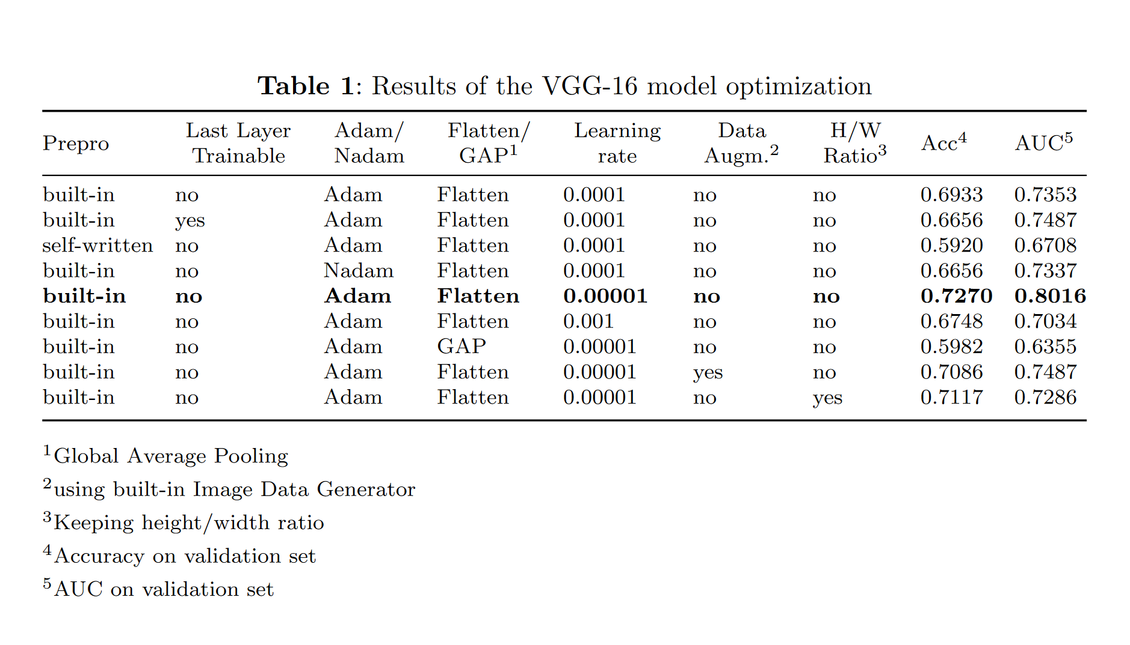
Results: VGG-16

Slide 14
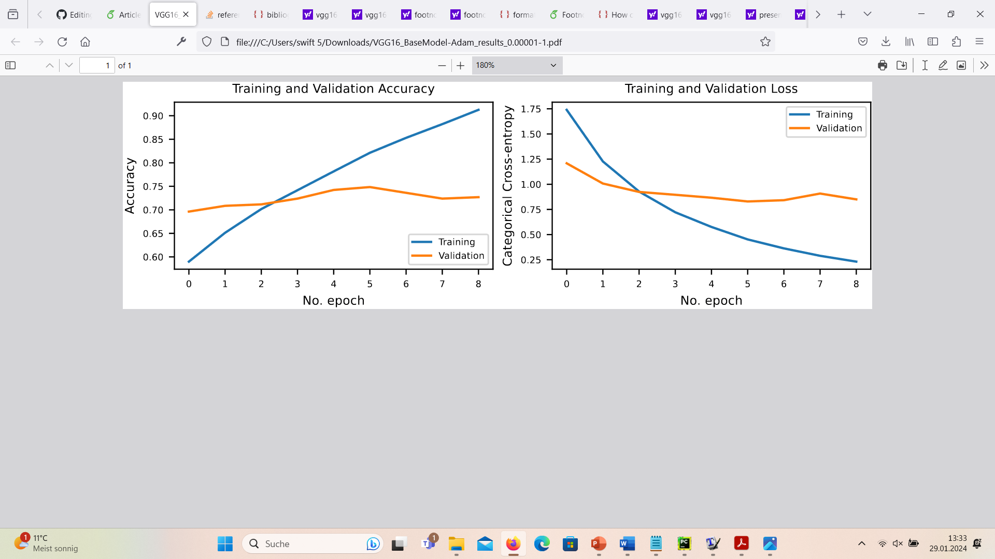
Results: VGG-16
 | Accuracy | AUC
Training | 0.913 | 0.967
Validation | 0.727 | 0.802

Slide 15
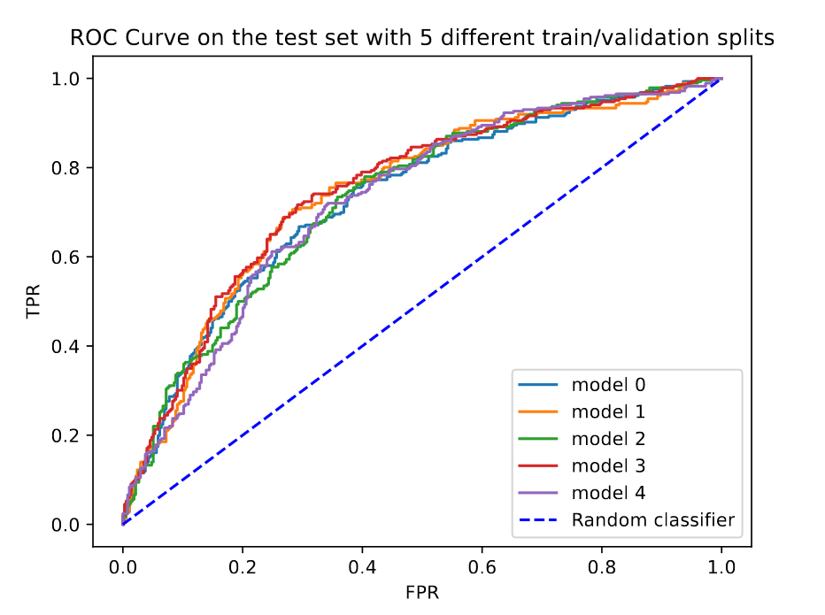
Results: VGG-16
 | Accuracy | AUC
Test | 0.686 | 0.737

Slide 16
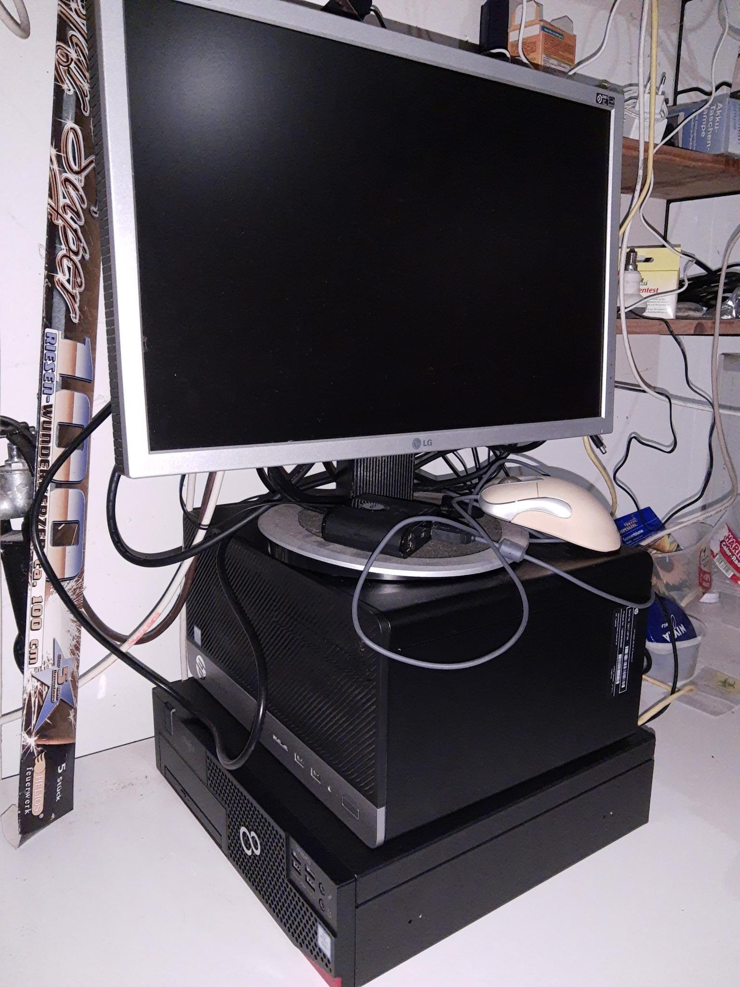
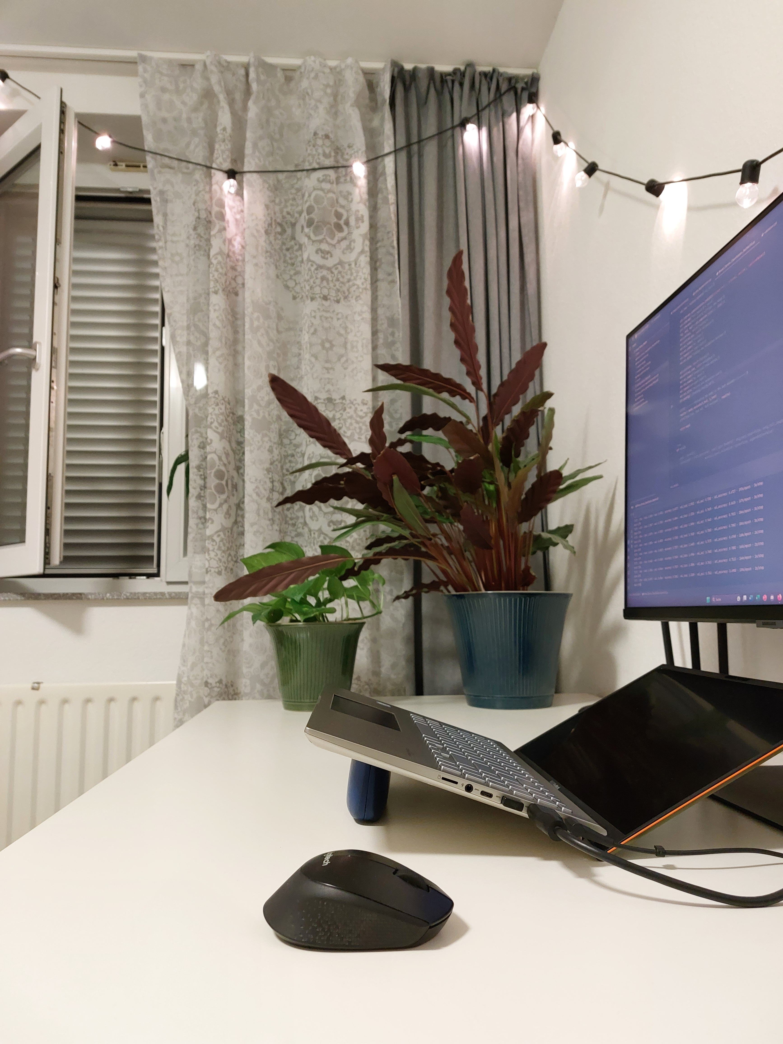
Limitations & Outlook

Slide 17
Limitations & Outlook
Thanks!

